Slide 1
Elements of a Block Diagram
CIS 305

Slide 2
A Note on Understanding System Architectures
Items that are grouped together and touch in some way (possibly on a capability the others depend on) bear a relationship to each other that must be defined in the details of the architecture document.
Items are arranged from top to bottom in order of dependency. The topmost items are dependent on the next tier and the bottom-most items support all items arranged above it.
Capability 3 in which 1&2 operate
Capability 1
Capability 1 depends on capability 2, and both 1 and 2 operate in a common ecosystem provided by capability 3
Capability 2

Slide 3
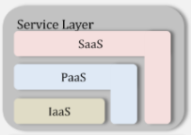
An Example from NIST
The primary services I/P/Saas are arranged in the order of dependency.
Altogether, they make up the parts of the substrate they ride on top of -- Service Layer. The substrate phrase can be used to describe the collection of elements.

Slide 4
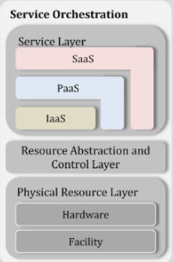
An Example from NIST (cont.)
But the Service Layer itself is just one of three parts of what is required to make up Service Orchestration.
In this orientation, the higher box depends on the lower boxes.

Slide 5
The components of our environment
Level 1 system OS hypervisor
Level 2 systems cloudstack-management cloudstack-agent hypervisor NTP NFS database bridge OS
Your block diagram should account for at least these; there are a few other parts you could include if you are so inclined

